Slide 1



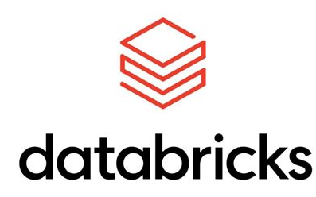


Your Technology
Guides
Your adventure starts here.

Slide 2
What is Dependency Injection?
Dependency Injection is a design pattern where a class does not create its own dependencies. Instead, they are provided (injected) from the outside, typically by a framework or container. This promotes loose coupling and improves maintainability.
Decouples components – Classes depend on abstractions, not concrete implementations.
Easier testing – Allows injecting mock dependencies for unit tests.
Better maintainability – Dependencies can be swapped or updated with minimal code changes.

Slide 3
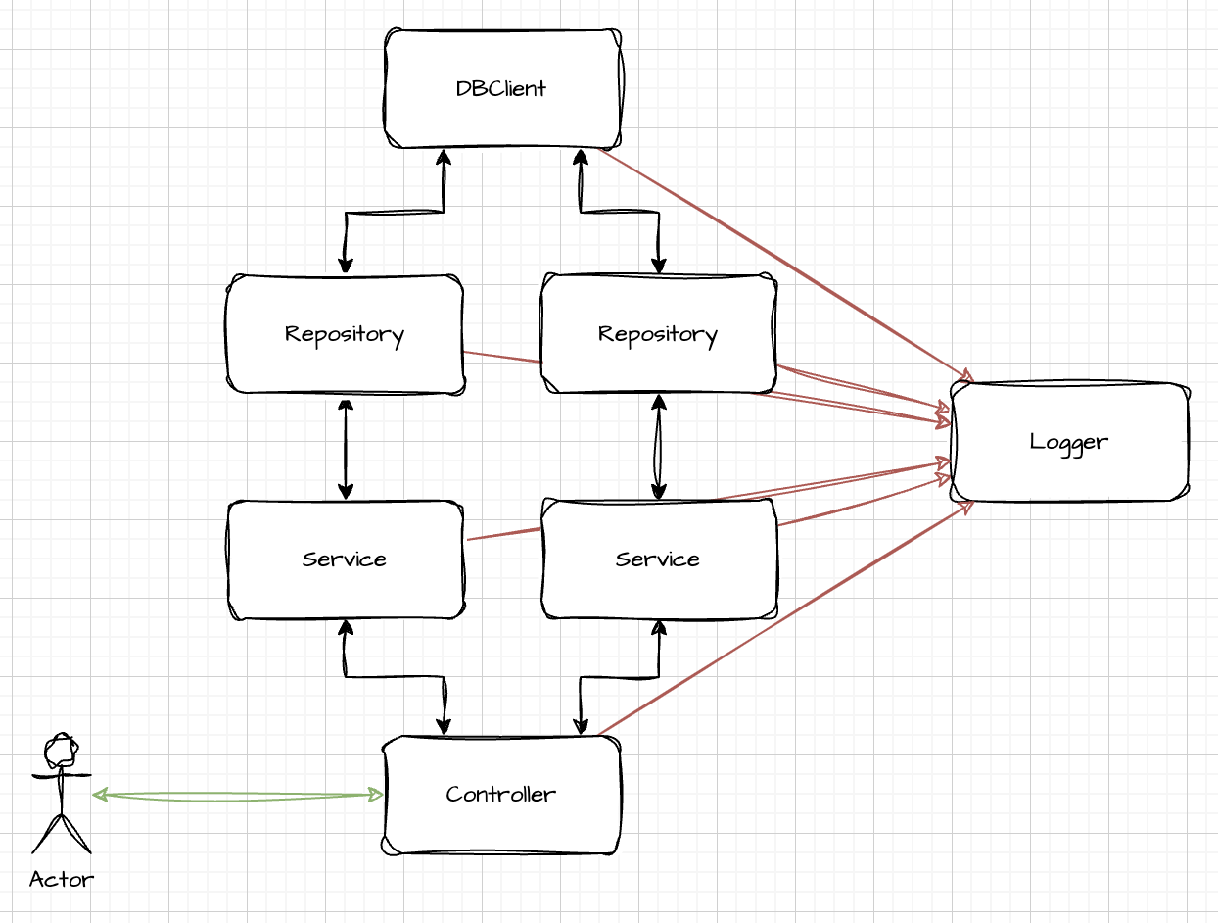
What is Dependency Injection?

Slide 4
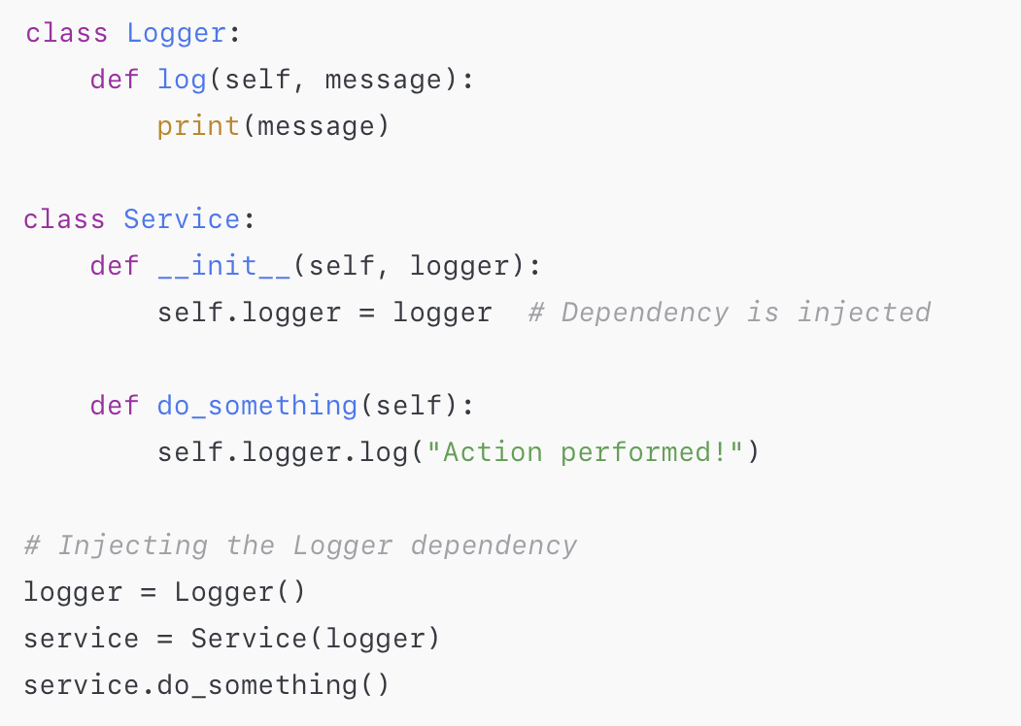
Quick illustration

Slide 5
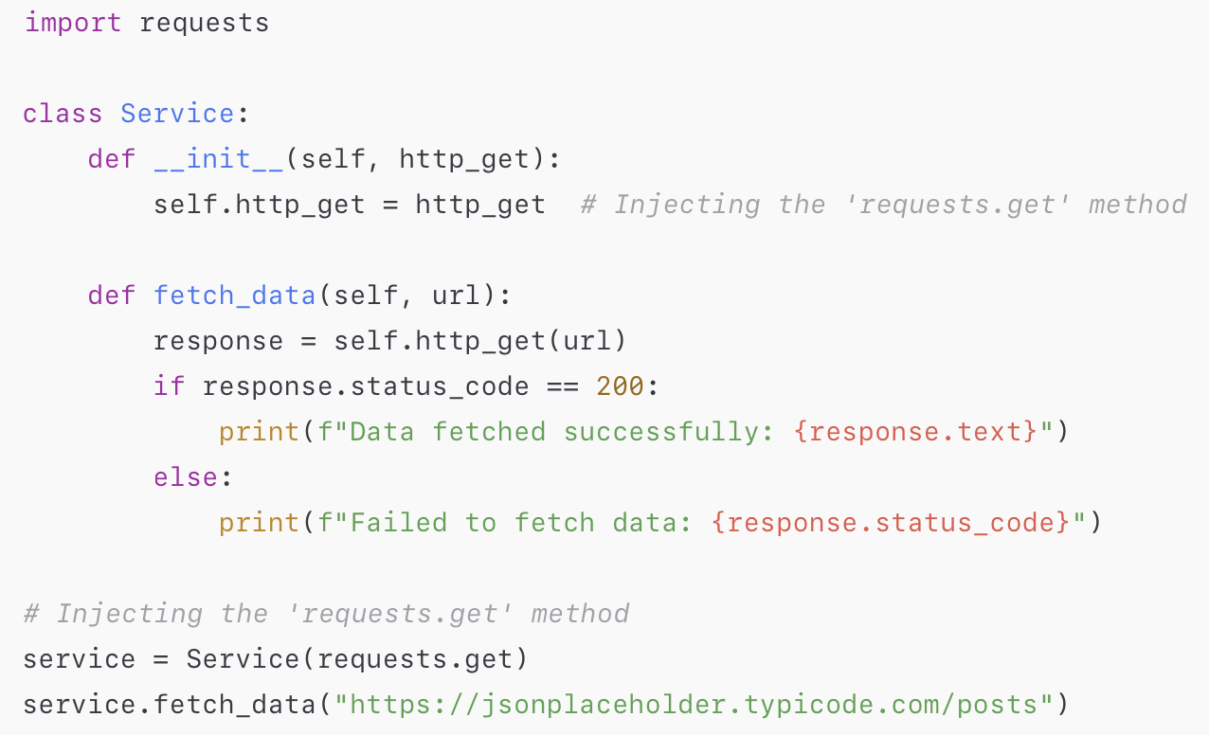
Another quick illustration

Slide 6

Common DI’s From Other Languages
Java
Spring/SpringBoot
Dagger
Google Guice
C#/.NET
Microsoft.Extensions.DependencyInjection
Ninject
Autofac
JavaScript
InversifyJS
Awilix

Slide 7
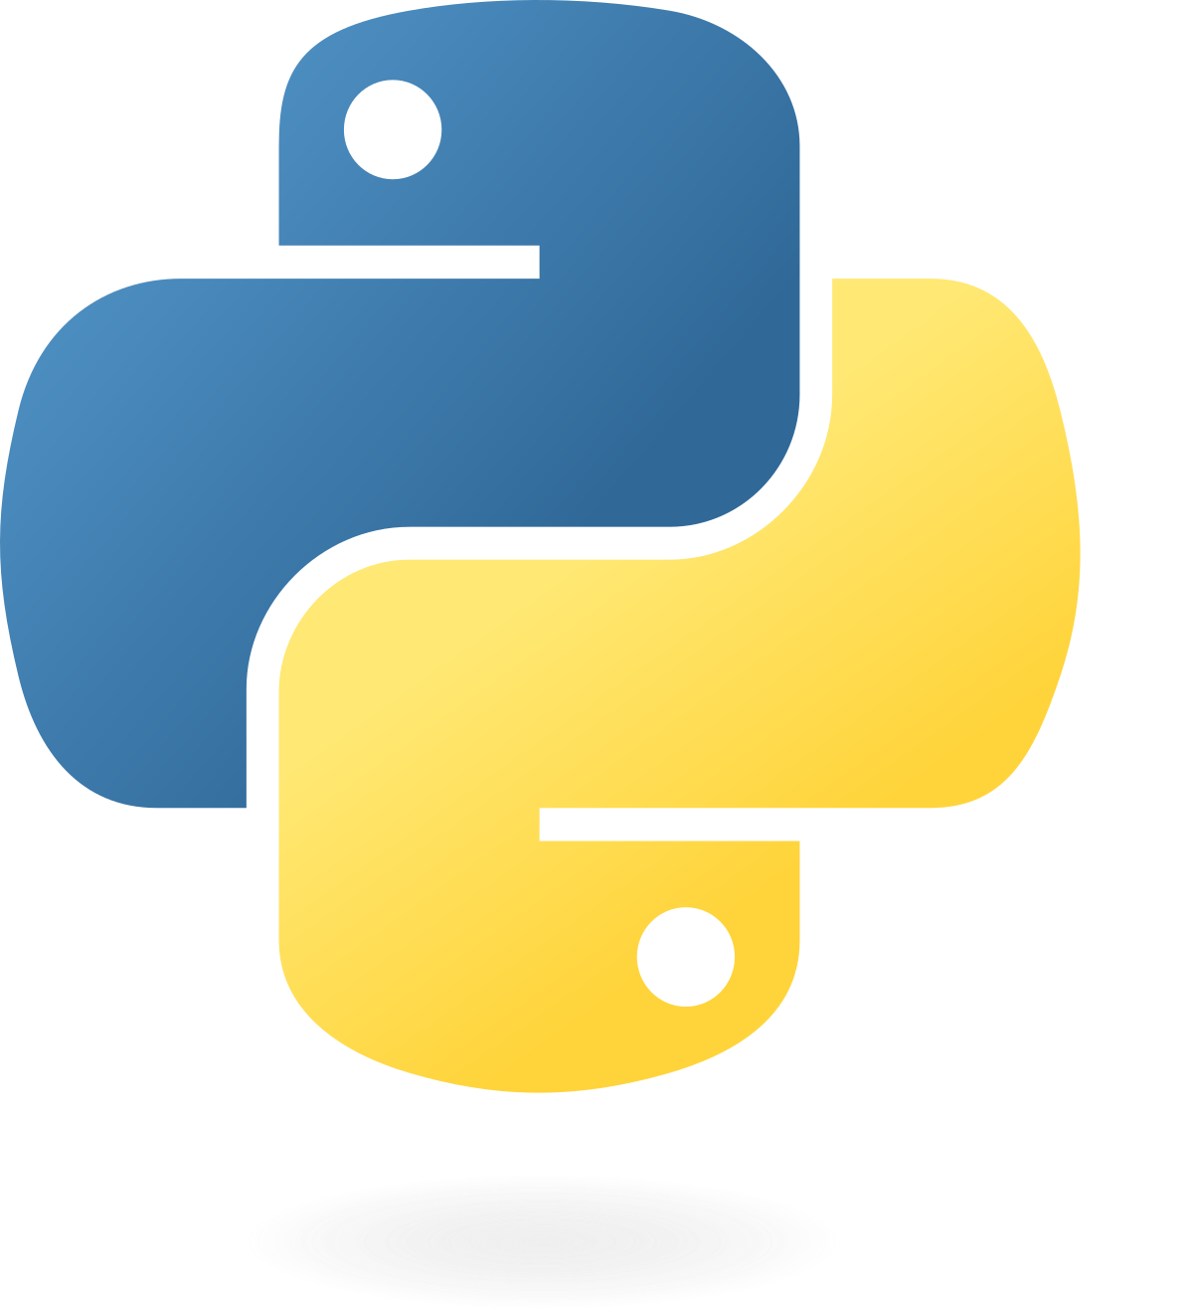
What about Python?
You can do it manually.
There are numerous stand-alone options:
dependency-injector
injector
others
Some packages have addons or built-in:
FastAPI (they provide their own)
Pytest (they provide their own as “fixtures”)
Flask (addon called flask-injector)

Slide 8
Ooze (https://pypi.org/project/ooze/)
Why I Created My Own Dependency Injector: "Ooze”
Challenge Accepted – I wanted to see if I could do it.
Scratching an Itch – There were things I like and don’t like about other implementations. Thought I’d explore the possibilities.
Spring Nostalgia – I miss Java's Spring, and existing Python DI solutions don’t quite match it.
Just for Fun – Because why not?

Slide 9

Demo time!

Slide 10
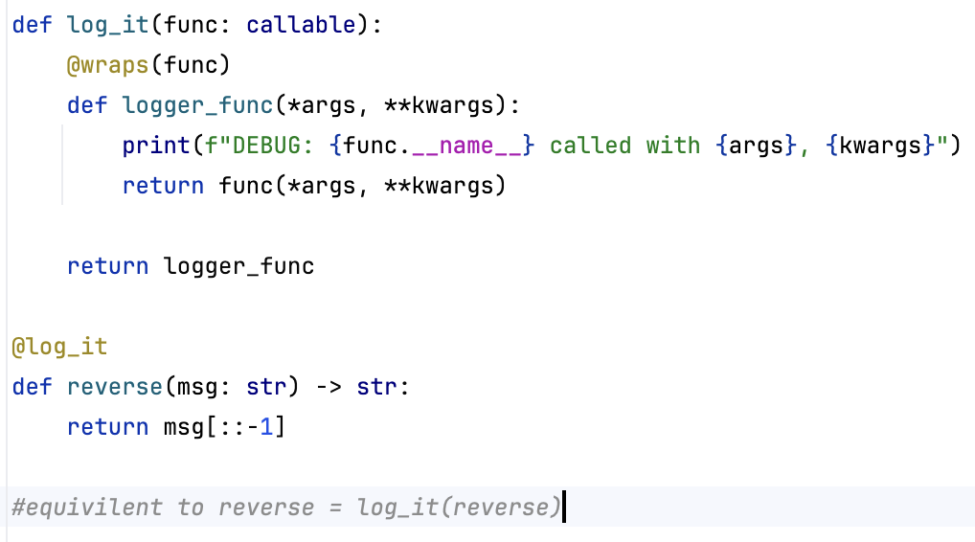
How does it work?
A novel use of the Python decorator pattern.

Slide 11
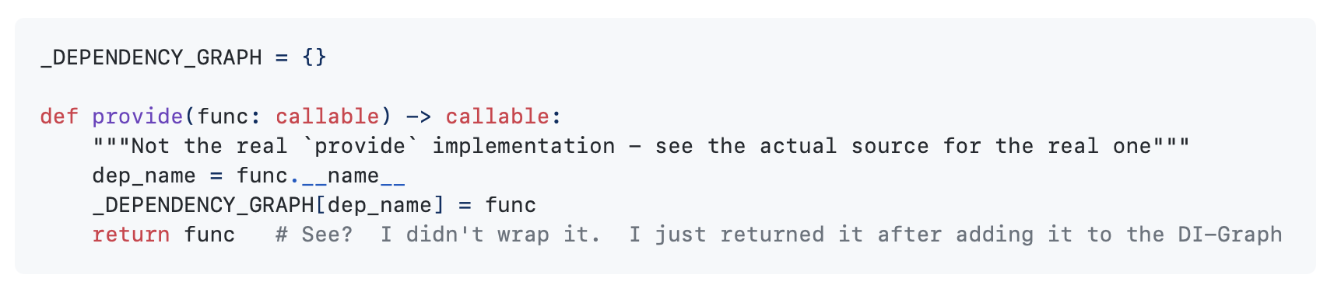
How does it work (continued)?
Rather than returning a new function in the decorator, add it to a DI-Graph and return the original function.

Slide 12
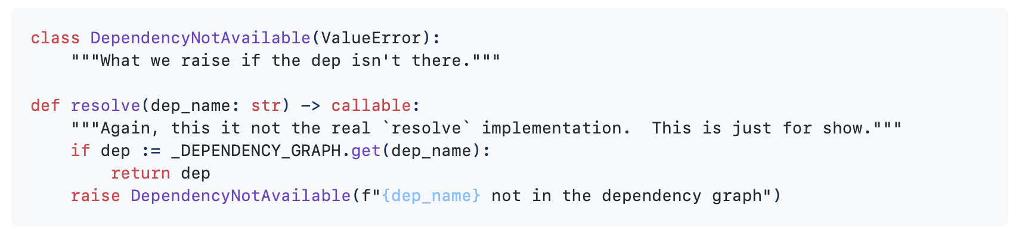
How does it work (continued)?
Later, then the script is executing, dependencies are needed. This is called “resolution”. Here’s the gist of that happens:

Slide 13
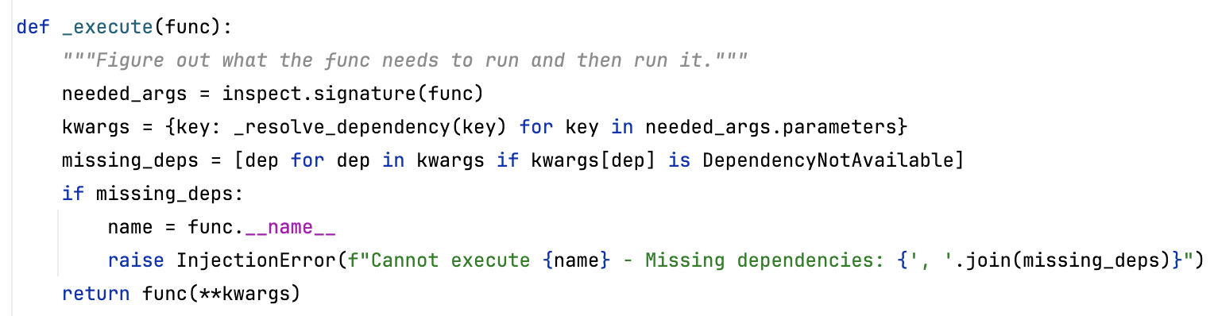
How does it work (continued)?
If the dependency is a Class, it needs to be instantiated. The __init__ arguments need to be determined to see if there needs to be cascading dependency injection. inspect.signature is your friend!

Slide 14
Dependency Injection In Review
It’s a pattern – can be implemented in most languages
Many benefits – will make your life easier in the long run
Makes writing unit tests easier
Makes it easier to keep your code modular
KISS, DRY, SRP
Code manageability – Once your code is organized it’s much easier to manage over time.
Tools – While you CAN do DI manually, there are tools to make it less tedious by automatically doing the injections for you.

Slide 15
Thank you - Questions?

